Slide 1

Aerospace React Web Application
Owen Lindsey
Professor Sparks, James
Milestone 5
12/06/2024

Slide 2

Project Overview
Purpose: - Efficient management of aircraft maintenance data.
- Centralized system for tracking aircraft performance and maintenance history.
2. Key Features:
- Aircraft data management.
- Maintenance record tracking.
- Performance metric monitoring .
3. Main Endpoints:
- /aircraft: manage aircraft information.
- /maintenance: Handle maintenance records.
- /performance: Track performance metrics.
- /performance-analytics: Shows data in various charts.

Slide 3

Technical Stack
Category | Technologies | Description
Frameworks | React 18 -– Frontend Express.js – Backend SQL Server - Db | React: Frontend library for building user interfaces and component-based web applications. - TypeScript: Superset of JavaScript for type-safe coding. - SQL Server: Relational database for storing application data.
UI Components | Shadcn/ui Lucide React Radix UI | Provides modern, accessible UI components including: - Tables, dialogs, and form controls. Icon components. Primitive UI components for building accessible interfaces.
Form Handling | React Hook Form Zod | React Hook Form: Performant form validation with flexible integration. Zod: TypeScript-first schema validation with seamless form integration.
Charts & Visualization | Recharts | A library for creating customizable and interactive charts, useful for displaying performance metrics and analytics.
Other Tools | Tailwind CSS React Router | Tailwind CSS: Utility-first CSS framework for styling. React Router: Handles navigation and routing in the React application.

Slide 4

Front End Component Structure
Component | Use
`PerformancePage.tsx` | Tracks key performance indicators. Implements the main performance metrics dashboard using React hooks (useState, useEffect) for state management. Integrates with Recharts library to visualize performance data through interactive charts and graphs. Features a child component PerformanceMetricDialog for CRUD operations on metrics.
`MaintenancePage.tsx` | Manages aircraft maintenance records and history. Utilizes React context for maintenance category filtering and search functionality. Implements maintenance record filtering through controlled components and state management. Features the MaintenanceRecordDialog component for adding and editing maintenance records.
`AircraftListPage.tsx` | Stores comprehensive aircraft data including model details, flight hours, and maintenance status. Uses React Router for navigation to performance metrics and maintenance history views. Incorporates shadcn/ui components for modern, accessible UI elements including dialogs for CRUD operations. Features the AircraftFormDialog component for aircraft management.

Slide 5
Front End Component Structure
Component | Use
`DashboardPage.tsx` | Implements a dynamic overview that displays a comprehensive summary of the aircraft fleet, including total aircraft count, maintenance status counts, and total flight hours tracked through React state hooks. Features an intuitive navigation system built with React Router, providing quick access to three primary sections: Aircraft Fleet Management (AircraftListPage) Maintenance Records (MaintenancePage) Performance Metrics (PerformancePage)
`PerformanceAnalytics.tsx` | Leverages the Recharts library to create sophisticated data visualizations: A Performance History section that displays a line chart tracking flight hours and fuel consumption over time. The chart uses a dual-axis configuration to show both metrics clearly, with flight hours on the primary axis and fuel consumption on the secondary axis. A Recent Activity Analysis section showing another line chart comparing flight duration against fuel efficiency. The values are scaled appropriately for meaningful comparison, with tooltips providing detailed information on hover. Real-Time Fuel Consumption is displayed as a prominent numerical value (like "573 gal/hr") with appropriate styling and typography to highlight current consumption rates. This value updates in real-time as new data comes in through the aircraftService.

Slide 6

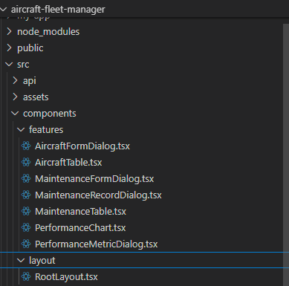
Support components
Component | Use
AircraftFormDialog.tsx | Handles both adding and editing aircraft data through a single reusable dialog component. Built using shadcn/ui Dialog component with form validation through React Hook Form.
MaintenanceFormDialog.tsx | Provides the interface for adding and editing maintenance records. Implements comprehensive form validation for maintenance details including type, category, and scheduling.
PerformanceMetricDialog.tsx | Manages the creation and updating of performance metrics for specific aircraft. Features numeric input validation and real-time data formatting.
AlertDialog.tsx | A shared confirmation dialog component from shadcn/ui used throughout the application for delete operations and other critical actions.
Edit-performance | Allows user to update performance metrics to the specified aircraft.
RootLayout.tsx | Serves as the application's layout wrapper, implementing the navigation structure and shared UI elements.

Slide 7
Aircraft endpoints
Display | Endpoint | Purpose
Aircraft Fleet page | http://localhost:4200/aircraft/2/performance/analytics | Displays all aircraft data from `aircraft` table in our database.
Maintenance Records page | http://localhost:4200/aircraft/2/maintenance | Displays the maintenance history for aircraft 2 in a table.
Performance Metrics page | http://localhost:4200/aircraft/2/performance | Displays the performance data for aircraft 2 in a table.
Performance Analytics page | http://localhost:4200/aircraft/2/performance/analytics | Displays the performance analytics in various charts on this page.
Dashboard | http://localhost:4200/dashboard | Displays the various pages supported by our application with a quick summary of each page.

Slide 8
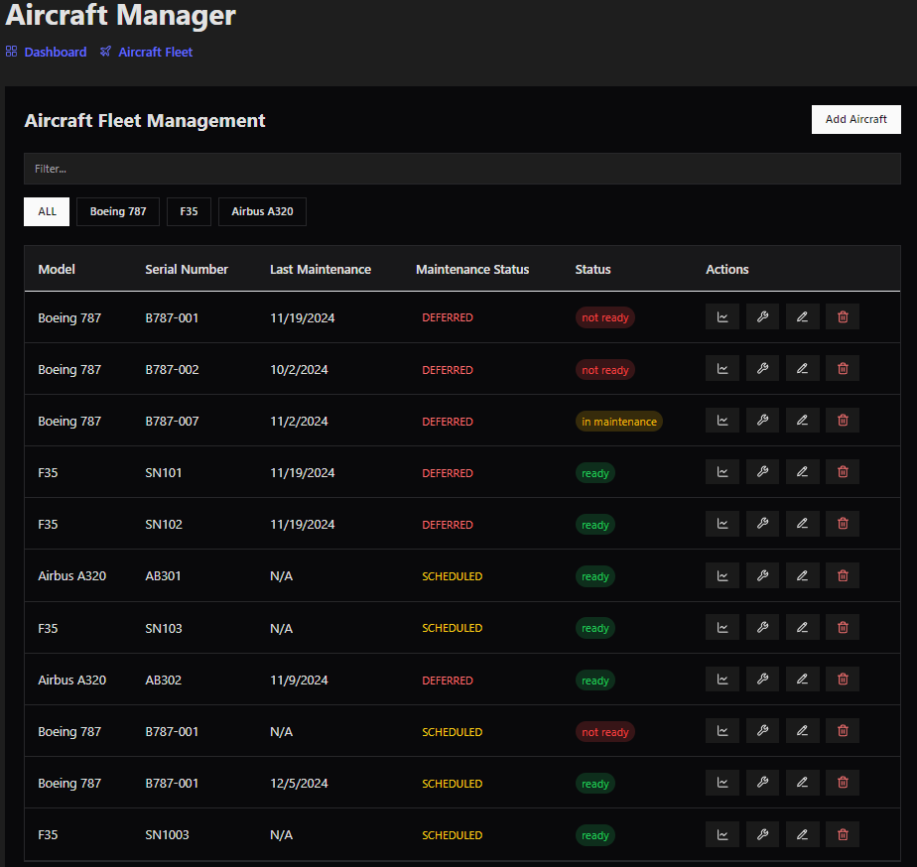
Aircraft-list Page

Slide 9
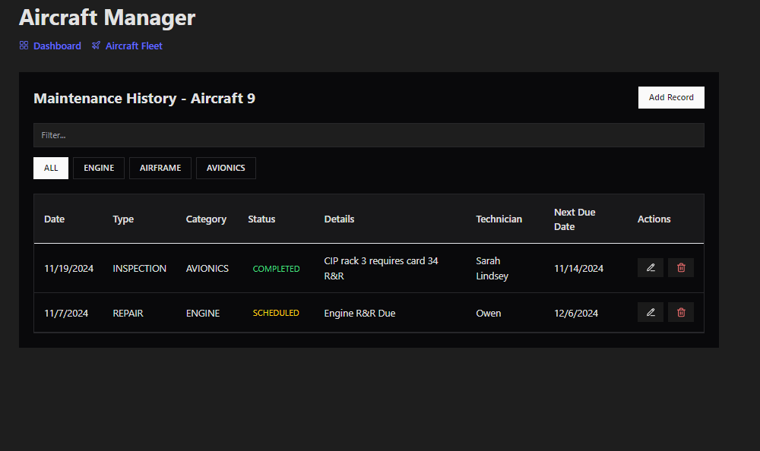
Maintenance-history Page

Slide 10
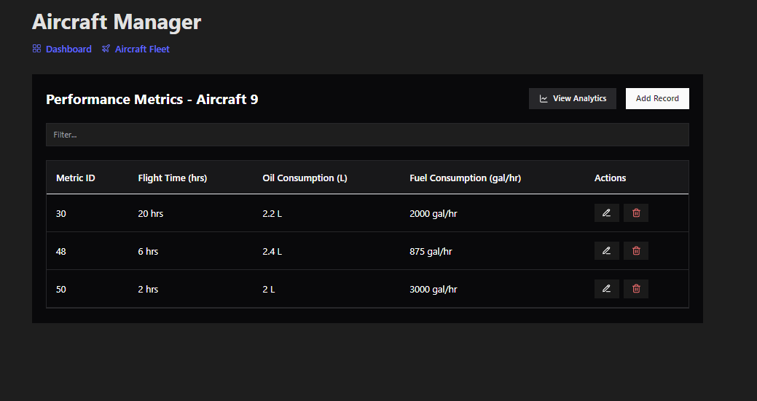
Performance-metrics Page

Slide 11
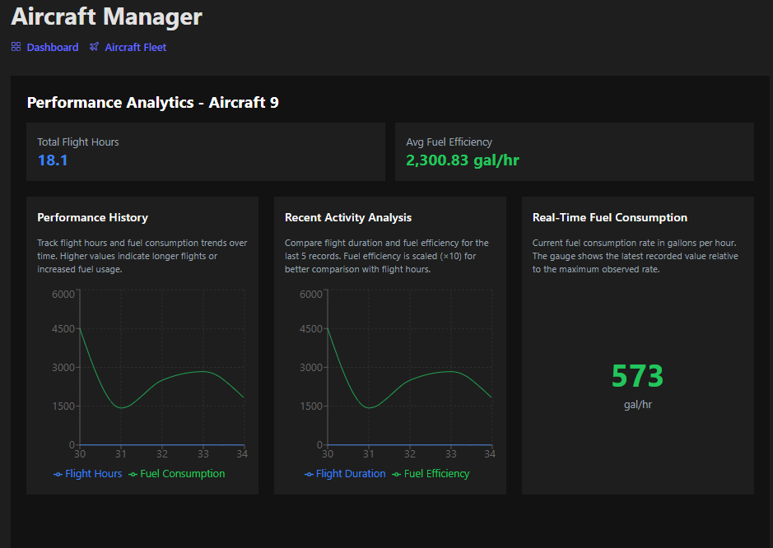
Performance-analytics Page

Slide 12
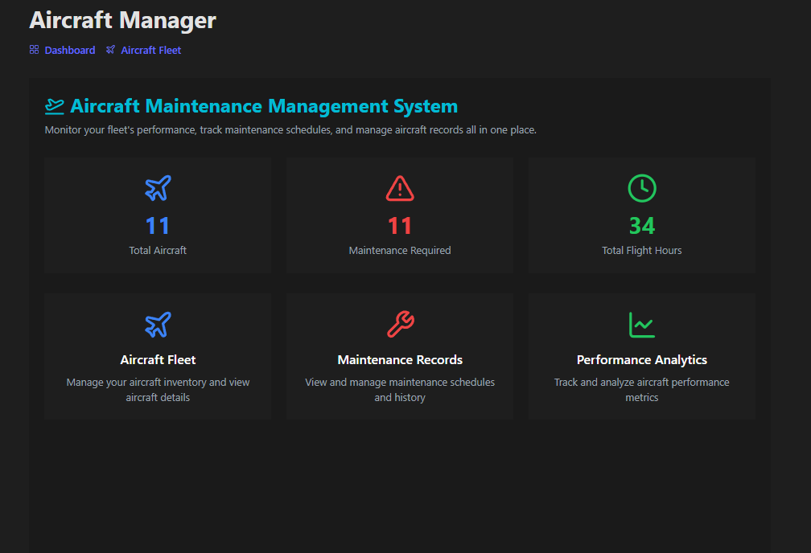
Dashboard Page

Slide 13
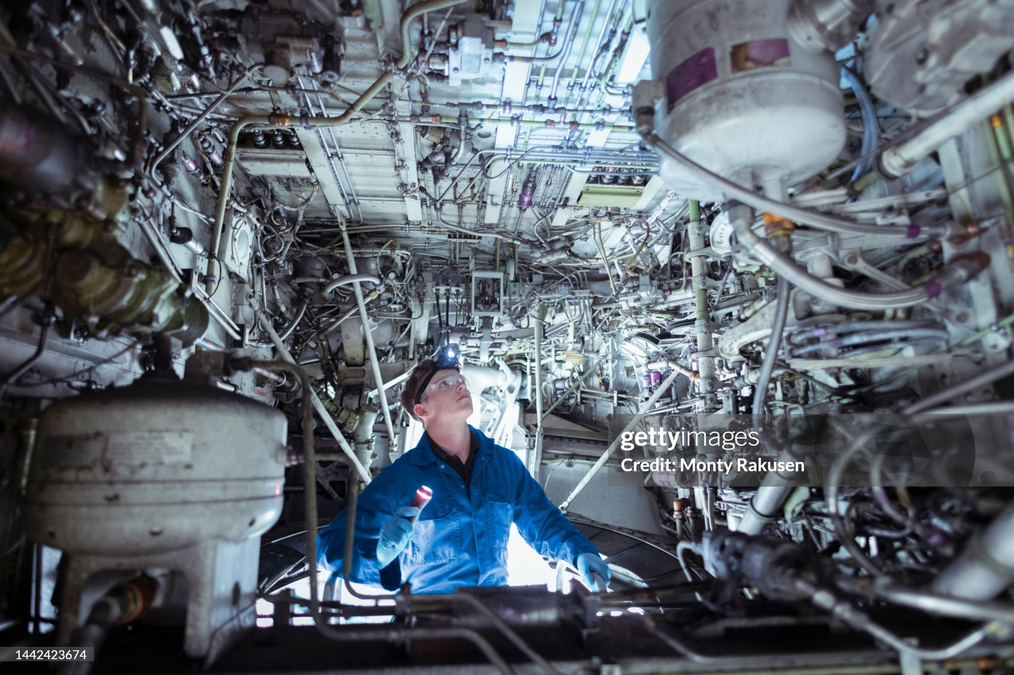
Challenges Encountered
Challenges | Reasoning | Example | solution
Data Consistency | Challenge: Ensuring that all related data remains consistent across different tables, especially when updating or deleting records. | Deleting an aircraft record without properly handling its related maintenance and performance records could lead to orphaned data or integrity issues. | Implementing cascading deletes in the database schema and careful transaction management in the API logic.
Date and Time handling | Managing and standardizing date and time data across different operations, especially considering potential timezone differences. | Storing maintenance dates in UTC but displaying them in local time, or handling date formats consistently between client requests and database storage. | Adopting a consistent date-time handling strategy, possibly using libraries like Moment.js, and clearly documenting date-time expectations in the API.
Error Handling and Input Validation | Implementing comprehensive error handling and input validation to ensure the API behaves predictably and provides useful feedback. | Dealing with various edge cases, such as invalid aircraft IDs, malformed date inputs, or attempting to create duplicate records. | Implementing middleware for input validation, creating custom error classes, and setting up global error handling to provide consistent, informative error responses across all endpoints.

Slide 14
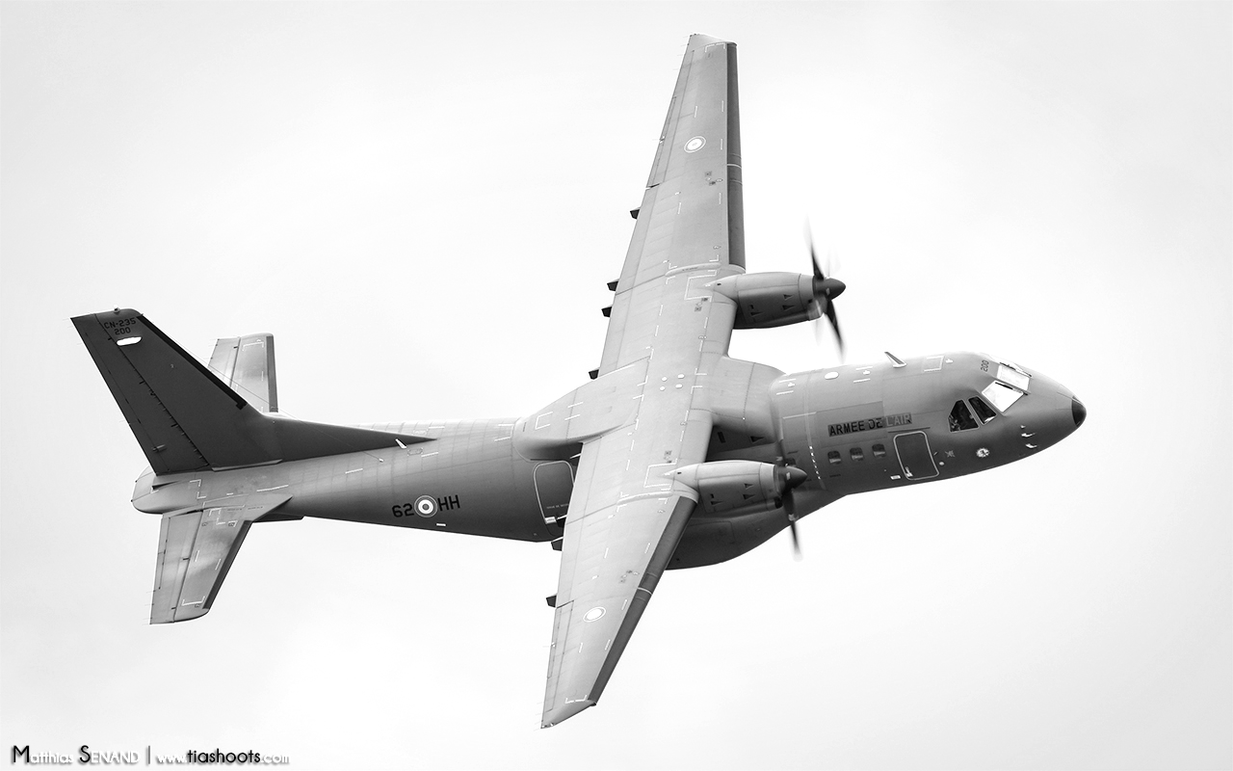
Pending bugs and current limitations
Current limitations | Future improvements
The web app is currently designed and tested only in a local environment, which may not reflect real-world environments. | Potentially Dockerize the application for easier deployment and scaling
The error handling could be more robust and informative. | Add HTTPS support for more secure communication in prod environment.
The web app has not been stress tested with large amounts of data or high simultaneous usage. | Possibly adding more features as time allows such as report generation and notification system for routine scheduled maintenance actions.

Slide 15

Lessons learned
Key take away | Explanation | Lesson
Importance of modular design | Sharing components when able is valuable. Modules allow components, directives, and services to be reused across different parts of my application. | design makes it easier to add or update features as the application grows. Each module can be developed independently and then integrated with the rest of the application, enabling better scalability.
Separation of concerns | Modules help keep related functionality organized by grouping components, services, and other resources together. This separation makes the codebase easier to navigate and maintain. | By having distinct modules, we can isolate and debug issues within a specific part of the application without affecting the entire system.
Efficient Loading | Angular supports lazy loading, where only the modules required at a given time are loaded. This can significantly reduce the initial load time of an application by deferring the loading of less critical modules. | By loading only what is necessary, modular design helps in optimizing performance, especially for large applications, by minimizing resource use.

Slide 16

Application to future web projects
Key take away | Lesson
UI with Angular Material | Experience with shadcn/ui and Tailwind CSS provides valuable insights into component-driven development. Understanding how to customize and extend these components demonstrates the ability to balance development speed with application-specific requirements.
Data Visualization | Proficiency with Recharts for creating interactive data visualizations shows the ability to transform complex data into meaningful insights. The skills in configuring responsive charts and managing real-time data updates transfer well to various monitoring and reporting systems.
Cross-functional Development | Experience working with frontend (React) and backend (Express, SQL) fosters versatility for full-stack development roles and effective project collaboration.

Slide 17

Postman documentation
Postman document

Slide 18

Live demonstration
Live demo

Slide 19

Web application repo
Web application documentation repo

Slide 20
Questions?

